Slide 1
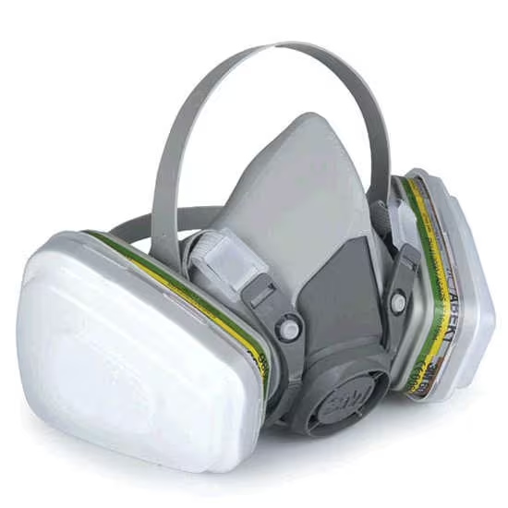
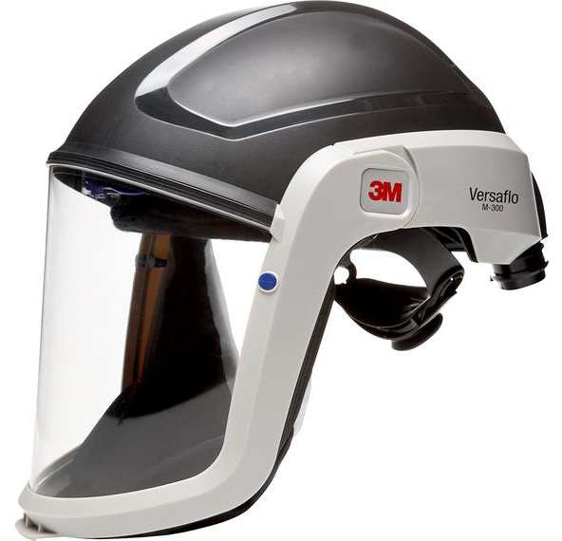
CLEAN SHAVEN-POLICY
1-9-2024

